Slide 1
Town Center Energy Resilience
Preparing for the future as the climate changes

Slide 2
Addressing climate change
Mitigation: energy efficiency, electrification, greening and strengthening the electricity grid
Adaptation: includes community resilience in the face of increasing hazards from extreme weather
Continuity of critical town services is critical for community resilience

Slide 3
ETIPP: Energy Transition Initiative Partnership Program
In June 2022, Chilmark and Aquinnah were accepted into the program
Not a grant: we are doing joint work with Lawrence Berkeley National Laboratory
Focus of work is the application of microgrids* to increase the energy resilience of town buildings
Goal is to understand the cost and benefit of this approach for the town centers of each community (scoping study)
Work to be competed mid-2024
* Microgrids are proven technology and have been deployed for a decade or more for resilience improvements at various scales – campus to neighborhood

Slide 4
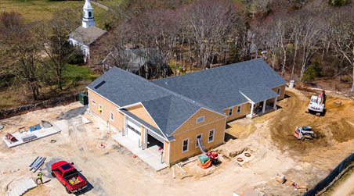
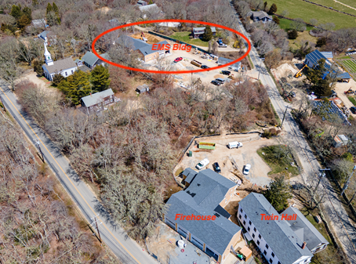
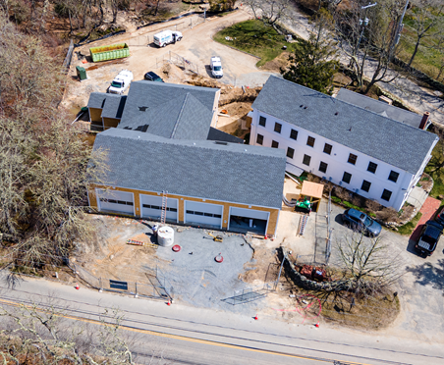
Town Center Buildings

Slide 5
Town Center Microgrid
EMS Array
EMS Bldg.
Fire House
Firehouse Array
Shared Generator
G R I D
Controller
Town Hall
Town Hall Array
Battery

Slide 6
Analysis / Simulation
Building models
Monthly energy use
Peak electricity loads by day of year
How much solar PV can we install?
Other simulation tools
Solar PV potential output
Capital cost estimates (based on level of resilience desired)
Operating costs (including electricity savings from solar)

Slide 7
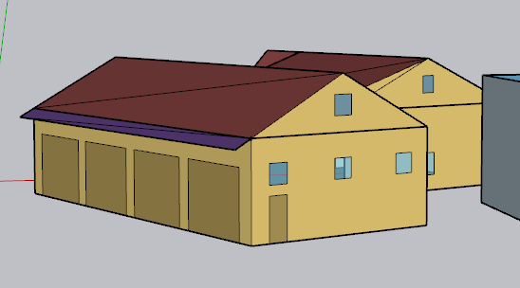
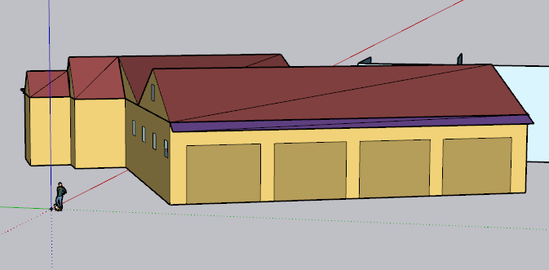
Building model example
Fire Station
Net conditioned building area: 466 m² (5015.98 sq ft)
Available images of the actual building

Slide 8
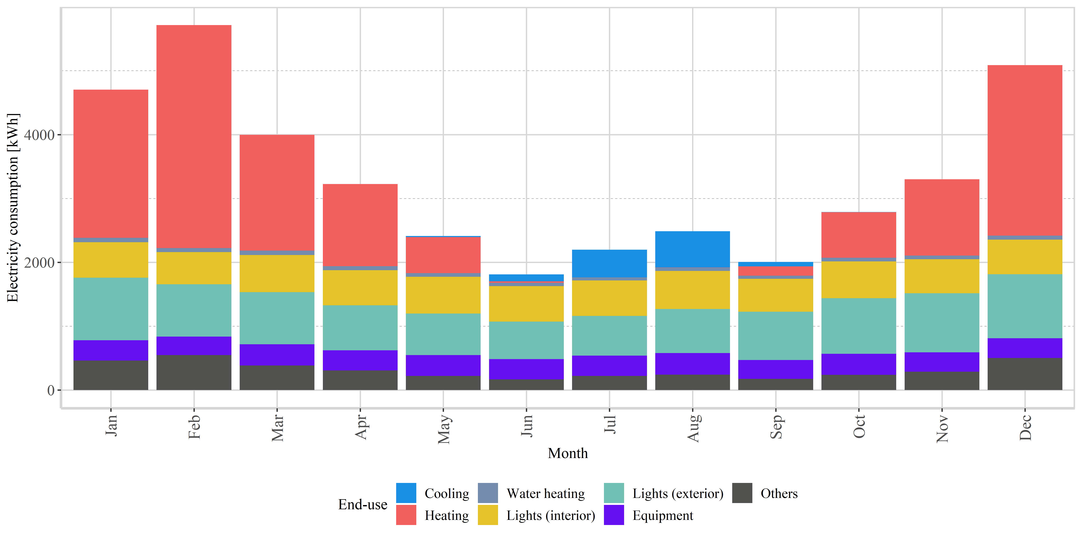
Example Results – Energy Consumption
Fire Station
Annual electricity consumption: 39723.12 kWh (85.2 kWh/m²)
Annual electricity consumption: 39723.12 kWh (85.2 kWh/m²)
Monthly electricity consumption

Slide 9
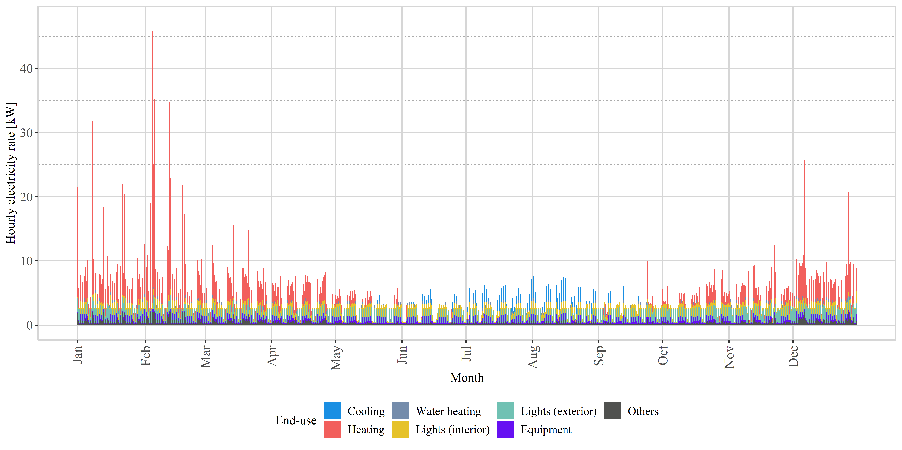
Example Results – Peak Power
Fire Station

Slide 10
Options Moving Forward
Solar for all / selected buildings
Lower electricity costs
Solar + battery for all / selected buildings
Lower electricity cost
Added resilience for lengthy outages
Financial benefit from Connected Solutions
Added local grid resilience
Full microgrid
Benefits of Option 2, plus:
Shared energy resources across buildings (larger battery + single generator)
Dynamic control / resource allocation
Projects could be phased…

Slide 11
Key Considerations
How much resilience do we want?
1 - 4 hours?
1 - 4 days?
1 week + ?
Ownership and management model
Town ownership and management
Lowest utility bills (+)
Bonding may be required (-)
Management and maintenance costs (-)
Developer leaseback and management
Smaller utility cost benefit (-)
Low capital investment (+)
Dependence on developer for maintenance (-/+)

