Slide 1
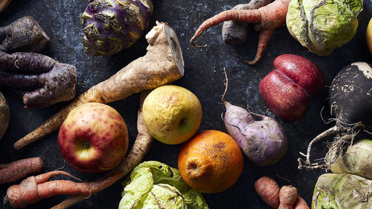
Food Waste on
Martha’s Vineyard
Notes:
The #1 export of Martha’s Vineyard is garbage –19,000 tons a year. 6500 tons of that is food that has been grown, processed, and transported to or around the Island is shipped back off-island as waste. In 2020, it cost the Island $ 743,535 to transport and dispose of this organic waste. According to MassDEP, 2,240 tons of food waste – 173 garbage trucks full of food waste must be recycled on Island every year. MassDEP created these regulations because food waste represent 8% of US greenhouse gas emissions.

Slide 2
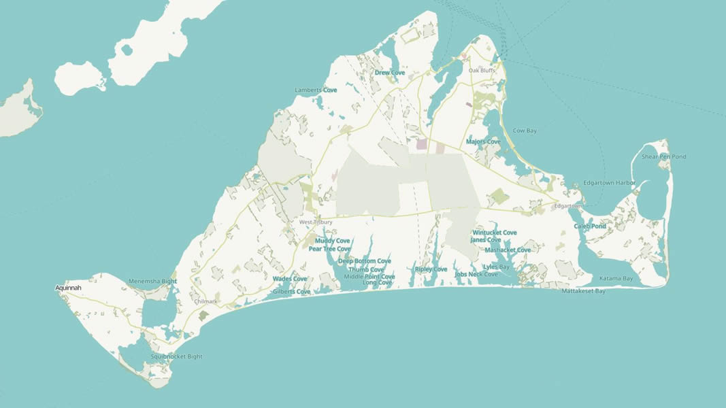
Exporting food waste from Martha’s Vineyard
Expensive, wasteful, harmful and illegal
Between 2025 and 2040
The Island will spend $19.4 million dollars to export all food waste.
37,500 cars will be displaced on the Steamship by 9,315 trucks of food waste and bulk compost.
The Island must to something with the 33,600 tons of food waste that must be recycled on Island per the Massachusetts Organics Ban.
As an Island on the forefront of climate change we can’t afford to be emitting additional greenhouse gasses.
Notes:
We know these costs will continue to rise as only 3 landfills in Massachusetts will accept other community’s waste by 2022. Already, 40% of Massachusetts solid waste is exported to New Hampshire, Maine and Ohio.
And we don’t have to

Slide 3
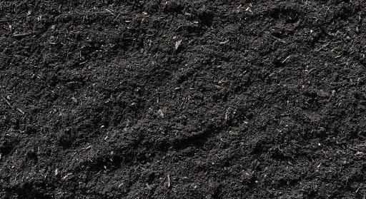
PROCESS FOOD WASTE ON ISLAND
Profitable, sustainable and climate-smart
If we processed 4000 tons of food waste per year on Island between 2025 and 2040
Collect $5.8 million in additional revenue in tipping fees and compost sales
Save $11.2 million in export and disposal costs
Enrich and restore Island soils with 60,000 cubic yards of Island-made compost, thereby creating more resilient and bountiful local agriculture
Limit the Island’s greenhouse gas emissions and absorb carbon dioxide in our composted soils

Slide 4
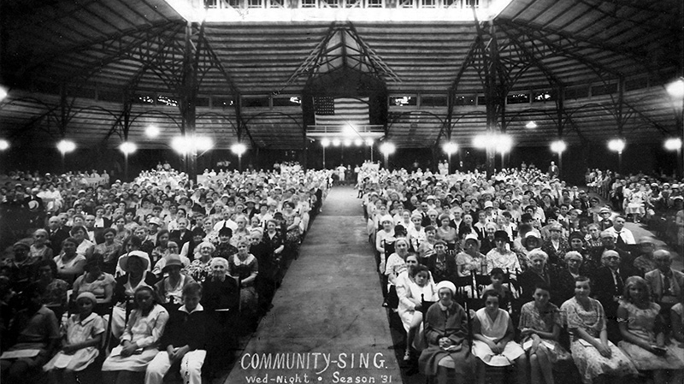
Islanders have been working on this for decades
Notes:
In the 2009, the Martha’s Vineyard Commission’s (MVC) 2009 Island Plan recognized the great expense of exporting waste off island and recommended converting waste into useful resources with an integrated, Island-wide program of waste management. Their recommendations included a large-scale composting facility to transform wasted food into a needed island commodity.
In 2015, a group of concerned Islanders, with support and funding from the Martha’s Vineyard Vision Fellowship, convened the Organics Committee to identify an Island response to the Massachusetts Organics ban.
Following the recommendations of the Committee, a food waste pick-up and composting pilot – Island Food Rescue (IFR) was launched in 2016 resulting in 17 tons of food waste recycled into compost.
Thanks to the contribution of the Katama-based Fink family, in 2019, an in-vessel composter and a food waste truck were acquired.
This machine can process up to 1000 tons of food waste a year.

Slide 5
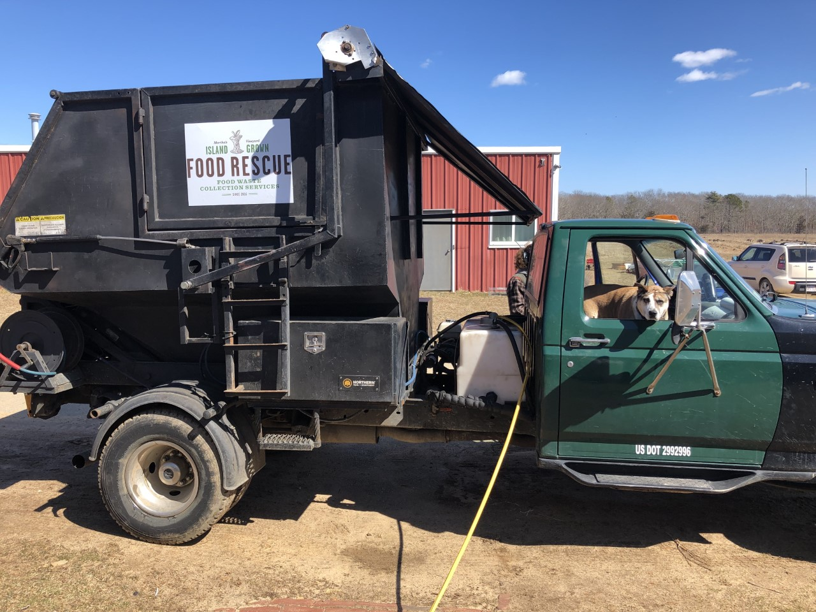
Notes:
The IFR food waste pilot has proven there is a food waste collection market at $85/ton, an uncured compost market at $20/ cubic yard a cured compost sales market at $60/cubic yard.

Slide 6
Notes:
If we processed 4000 tons of food waste per year on Island between 2025 and 2040
$5.8 million in additional revenue could be collected in tipping fees and compost sales
Save $11.2 million in export and disposal costs
60,000 cubic yards of compost would enrich and restore Island soils creating more resilient and bountiful local agriculture.
Stop a significant portion of our greenhouse gas and our composted soils would take carbon out of the atmosphere. 2700 lbs more per acre.

Slide 7
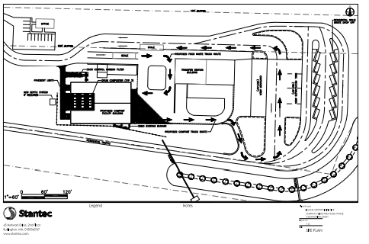
Notes:
In 2020, the third in a series of reports commissioned by the Committee to study the issues and opportunities around food waste on Island outlined specifications and estimated all-in capital costs for an in-vessel drum to compost all Island food waste at $9,826,496 for MVRD.
The MVRD has an expansion plan in place, approved by the four towns in the district and the MV Commission, to provide a location for an in-vessel drum, and are awaiting final approval from the MassDEP.
The $9 million Capital expense requires investment from all six Island towns. Commercial waste and the majority of residential curbside collection waste is tipped through the Edgartown and OB transfer stations, dramatically skewing town-by-town waste data on Island.

Slide 8

Local business partners in the composting operation
Bruno’s Rolloff will collect food waste and pay a tipping fee to drop food waste at MVRD.
Keene’s Excavation will pay MVRD for uncured compost to cure and truck it back to their site for curing and sales.
Notes:
The composting operation a scale here requires three separate components: collection, processing and curing/compost sales

Slide 9
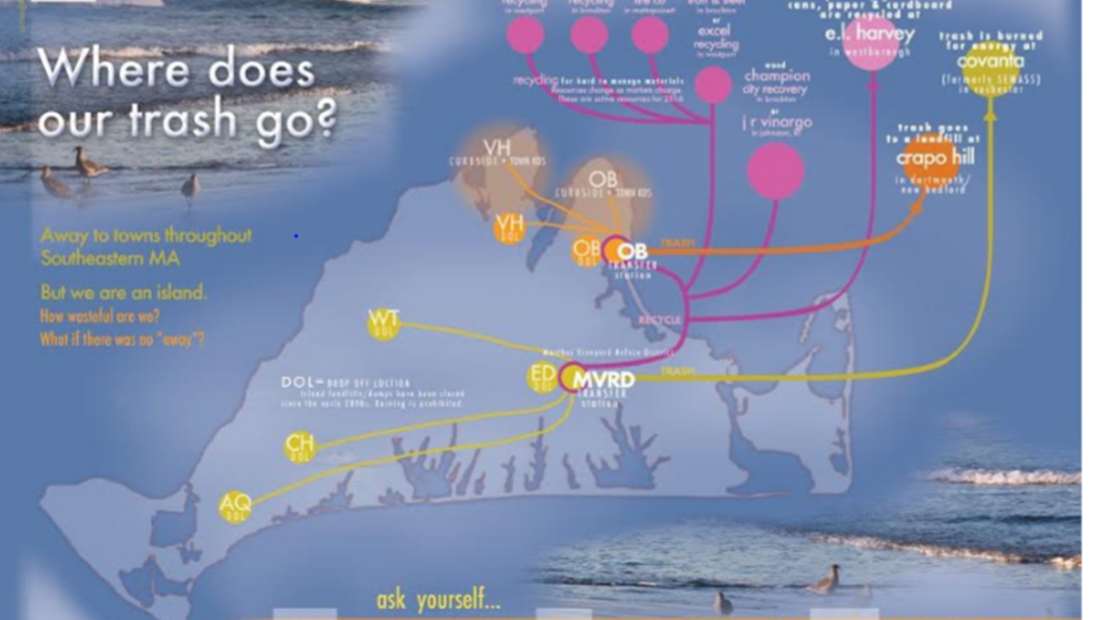
Notes:
The $9 million Capital expense requires investment from all six Island towns.
There are two separate trash systems on Island – that of Tisbury/OB and that of the 4 MVRD towns.
The 19,000 tons of exported solid waste is nearly equally divided between both systems.
The waste business is an economy of scale in that the more volume produced the less it costs per unit. This is true for exporting solid waste off-Island and it is true for processing food waste on Island.

Slide 10

Questions?
What’s next?

Slide 11
STOP

Slide 12
We need your help!
Building support in your town and sharing information
An equitable share of costs for all six Island town.

Slide 13
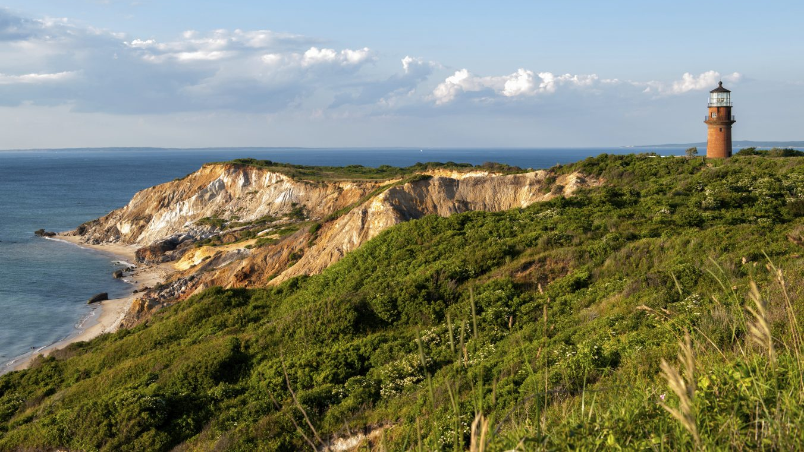
Thank you.

Slide 14
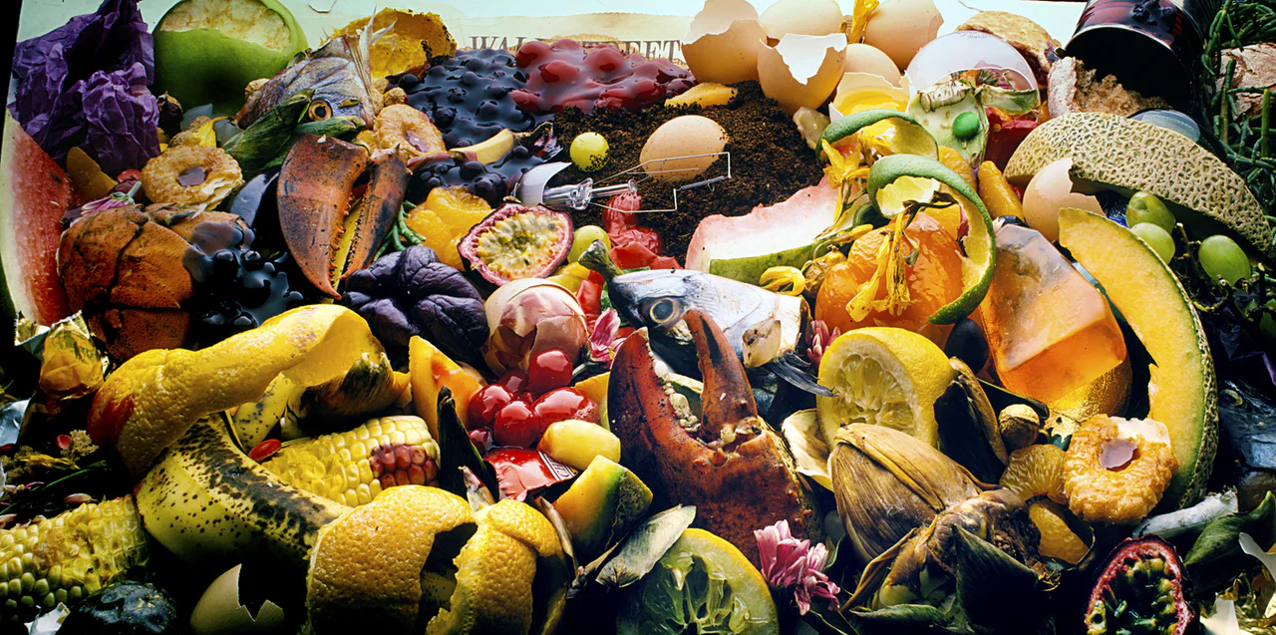
Each Year, 6500 tons of food that has been grown, processed, and transported to or around the Island is shipped back off-island as waste.

Slide 15
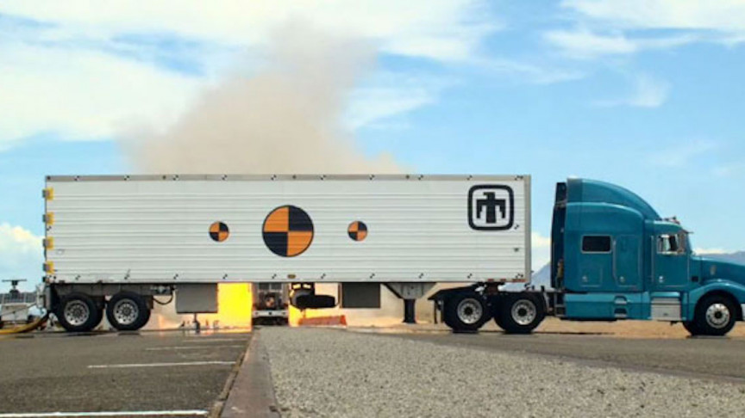
That’s 621 trucks taking the place of 2500 cars on the Steamship to export food waste and import bulk compost. Every year.

Slide 16

In 2020 alone, it cost the Island
$ 743,535
to transport and dispose of this organic waste in landfills off-island

Slide 17
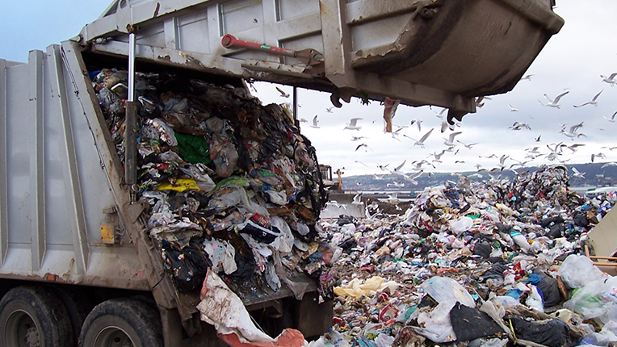
In 2020, it cost the Island
$ 743,535
to transport and dispose of 6500 tons of organic waste

Slide 18
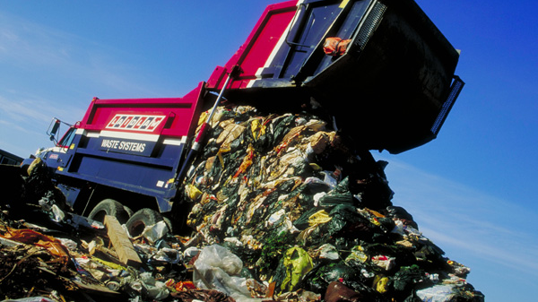
According to MassDEP, 2,240 tons of food waste –
173 garbage trucks full of food waste must
be recycled on Island every year,
but they are illegally disposed of.

Slide 19
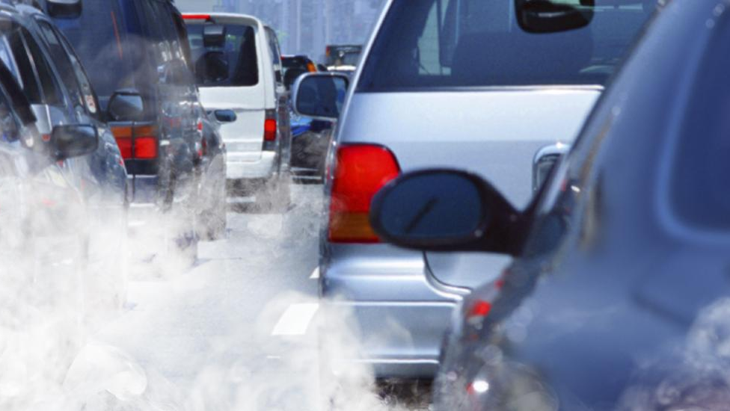
In the US in 2014, landfill gas from food waste emitted the equivalent of 163 million tons of carbon dioxide, that’s about the yearly emissions of 31 million cars.

Slide 20
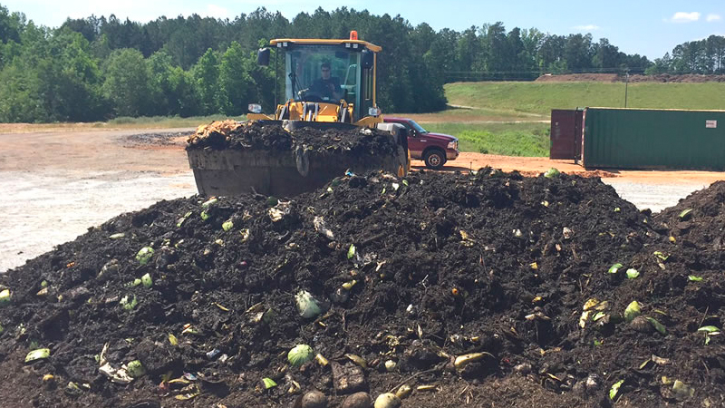
There is an alternative.

Slide 21
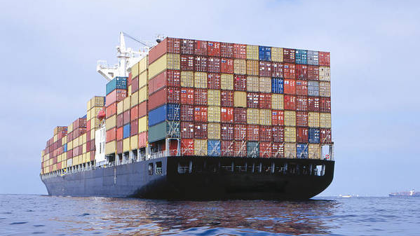
We know these costs will continue to rise as only 3 landfills in Massachusetts will accept other community’s waste by 2022. Already, 40% of Massachusetts solid waste is exported to New Hampshire, Maine and Ohio.

Slide 22
How do we know all this?

Slide 23

In the 2009, the Martha’s Vineyard Commission’s (MVC) 2009 Island Plan recognized the great expense of exporting waste off island and recommended converting waste into useful resources with an integrated, Island-wide program of waste management.
Their recommendations included a large-scale composting facility to transform wasted food into a needed island commodity.

Slide 24

In 2015, a group of concerned Islanders, with support and funding from the Martha’s Vineyard Vision Fellowship, convened the Organics Committee to identify an Island response to the Massachusetts Organics ban.

Slide 25
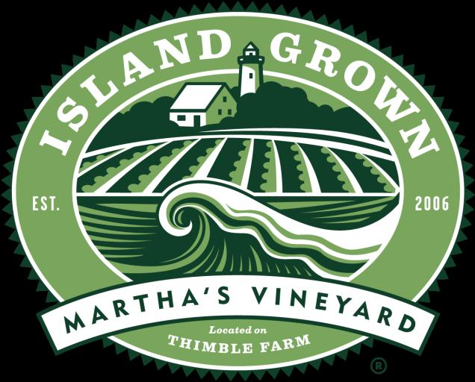
Following the recommendations of the Committee, a food waste pick-up and composting pilot – Island Food Rescue (IFR) was launched in 2016 resulting in 17 tons of food waste recycled into compost.

Slide 26
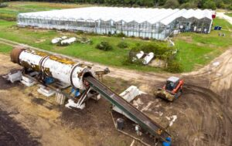

Thanks to the contribution of the Katama-based Fink family, in 2019, an in-vessel composter and a food waste truck were acquired.
This machine can process up to 1000 tons of food waste a year.
In 2019, 360 tons of food waste were processed - proving a market demand for both food waste collection and compost sales.

Slide 27
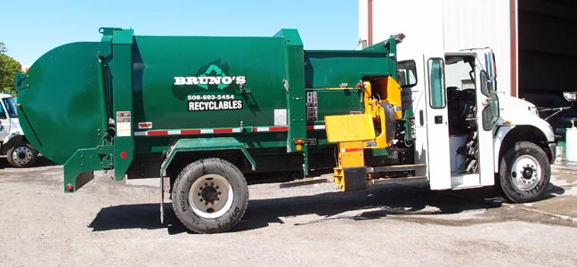
In January of 2020 Bruno’s Roll-off assumed food waste collection.

Slide 28
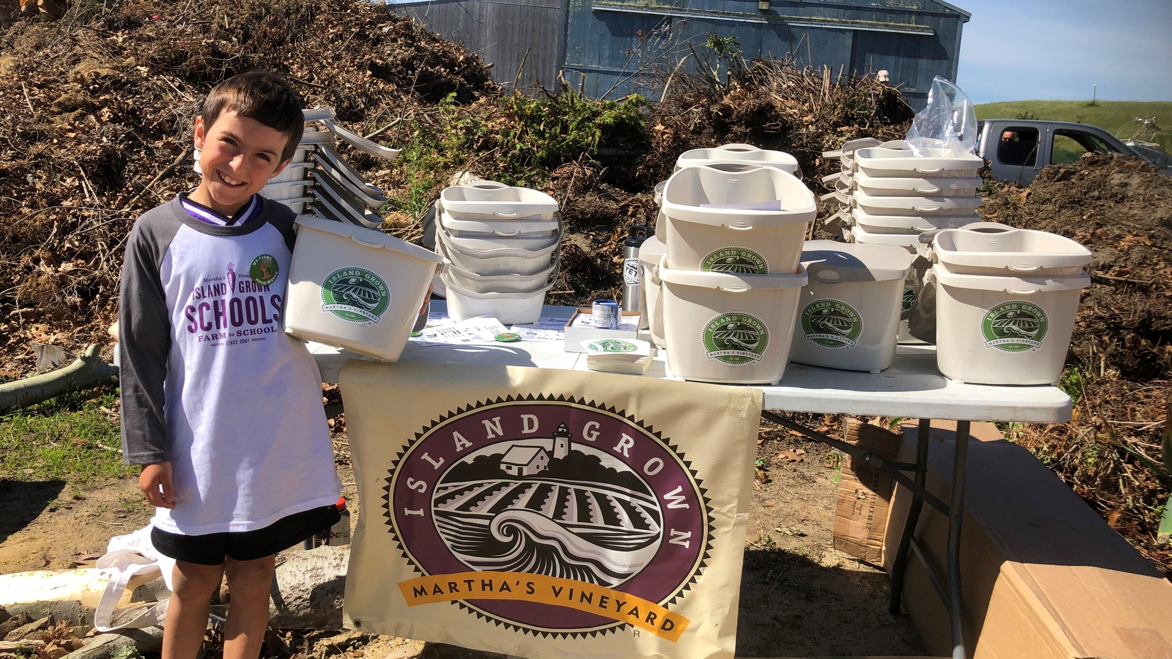

Slide 29
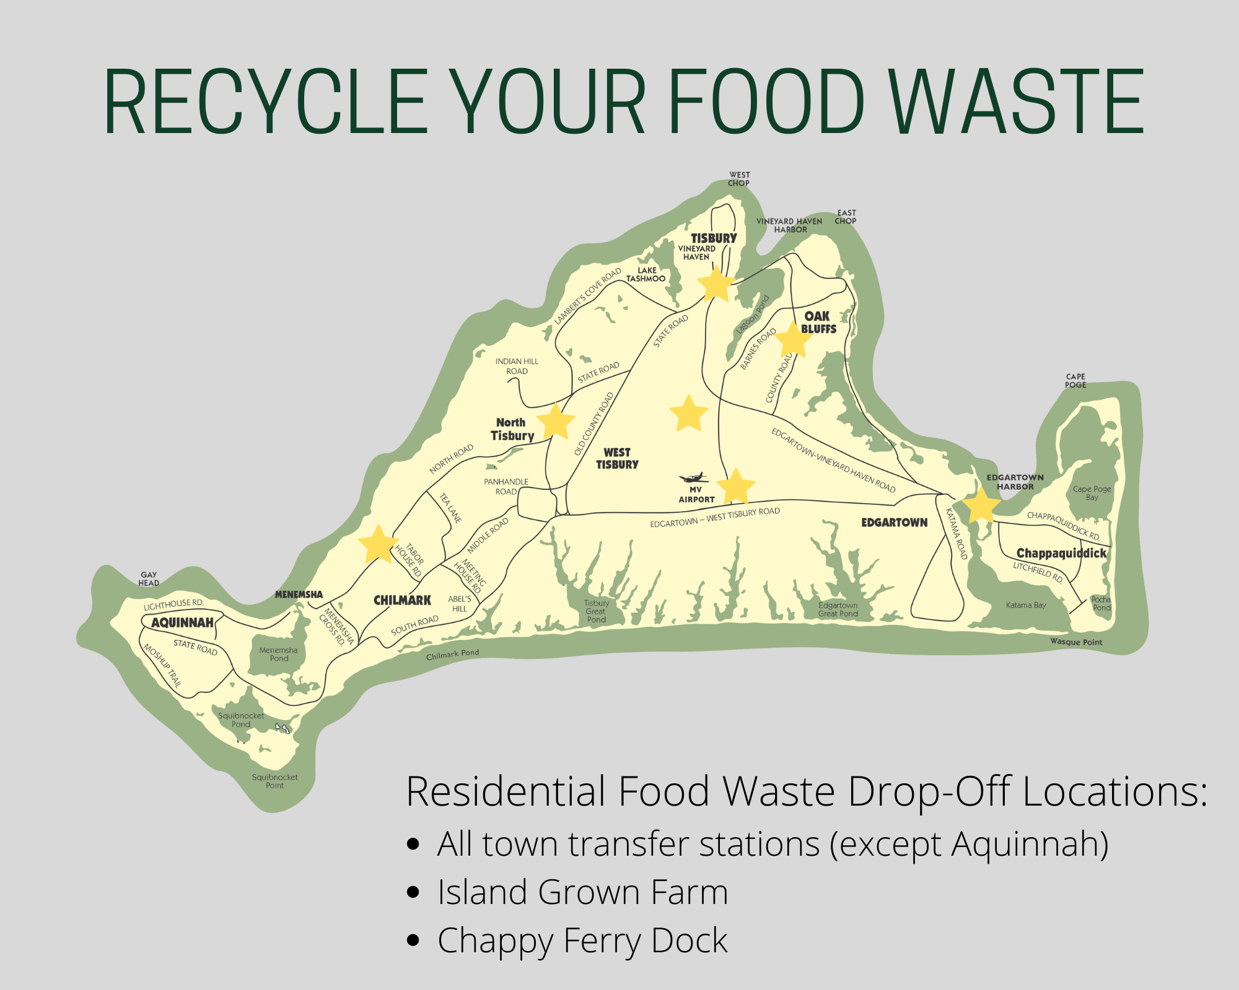
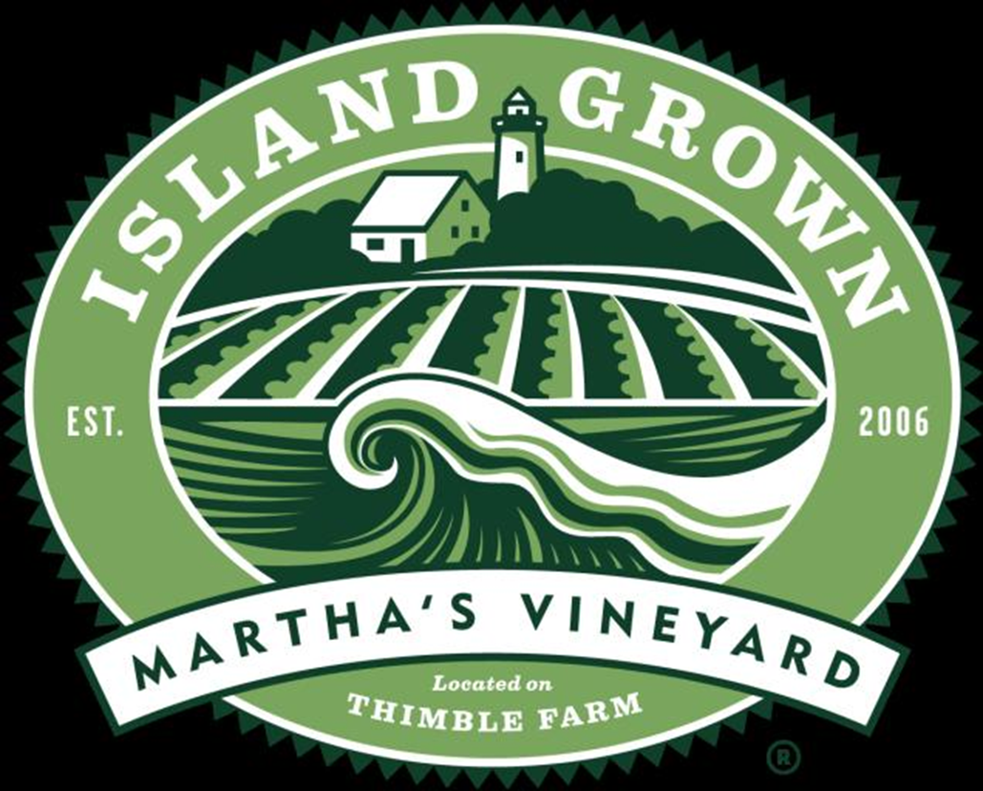
As of June, 2020 all seven residential food waste drop-off locations were made free.

Slide 30

In 2021, John Keene will begin to pilot a curing process to cure Island compost at scale – 4,000 cubic yards.

Slide 31
If we do not process locally in the future, the Island will spend $19.4 million dollars between 2025 and 2040 to export 6500 tons of food waste each year.
The IFR food waste pilot has proven there is a food waste collection market at $85/ton, an uncured compost market at $20/ cubic yard a cured compost sales market at $60/cubic yard.
If the Island collected and processed 4000 tons of food waste here at MVRD, $5.8 million in additional revenue could be collected between 2025 and 2040 in tipping fees and compost sales. That is in addition to $11.2 million saved on export costs.
That is $17 million in savings and revenue for the Island over 15 years.
Factoring out operations costs, the NET return over 15 years is $11.2 million
After covering Capital expenses of $9,826,496, the Island would see a full return on investment within 15 years.

Slide 32
In 2020, the third in a series of reports commissioned by the Committee to study the issues and opportunities around food waste on Island outlined specifications and estimated all-in capital costs for an in-vessel drum composting system at $9,826,496 for MVRD.
The MVRD has an expansion plan in place, approved by the four towns in the district and the MV Commission, to provide a location for an in-vessel drum, and are awaiting final approval from the MassDEP.

Slide 33

The $9 million Capital expense requires investment from all six Island towns. Commercial waste and the majority of residential curbside collection waste is tipped through the Edgartown and OB transfer stations, dramatically skewing town-by-town waste data on Island.
There are two separate trash systems on Island – that of Tisbury/OB and that of the 4 MVRD towns.
The 19,000 tons of exported solid waste is nearly equally divided between both systems.
Waste is a volume business, in that the more volume produced the less it costs. This is true for exporting solid waste off-Island and it is true for processing food waste on Island.
There is no question that the most economical approach to all waste management on Island is a six-town waste system.

Slide 34
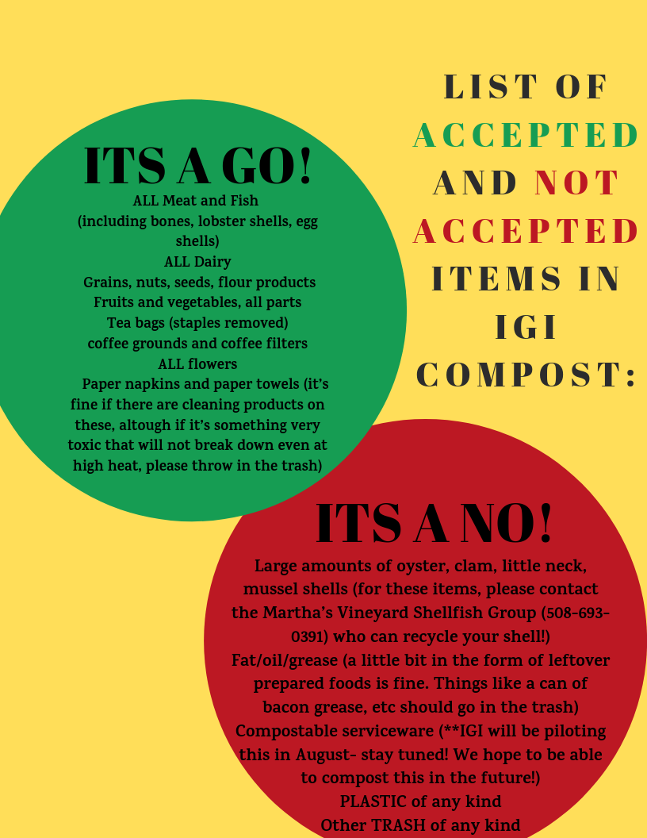
The MV Food Waste Initiative, along with partners Bruno’s Rolloff and Keane’s Excavation will continue to grow the compost collection pilot to reach 1800 tons of food waste collected, processed and sold as in 2025.

