Slide 1
Chilmark Organizational Review Human Resource Board Update and Discussion 3/2/23

Slide 2
Agenda
Share Final Recommendations
Surface questions and concerns
Discuss next steps

Slide 3
Final Recommendations Process
Bill R, Tim C and Don L reviewed, debated work-in-process recommendations, confirmed needs to be met, identified alternative solutions, reviewed final document
Researched other MV Town roles and structures

Slide 4
Recommendations
Recognize current Town Administrator role design as overly broad; refine to generate greatest value
Add new roles
Assistant Town Manager to address overly-broad Town Administrator role
Director of Human Resources to develop and implement core management and human resource processes
Formalize Financial Management Team to ensure coordination across all finance functions
Immediately, convene Financial Management Team with facilitation support to create integrated, coordinated calendars and schedules between and within all financial functions to increase efficiency and effectiveness and to reduce staff re-work and frustration
Develop and document consistent human resources processes
Clarify roles of Boards, appointed officials and town staff as Phase II

Slide 5
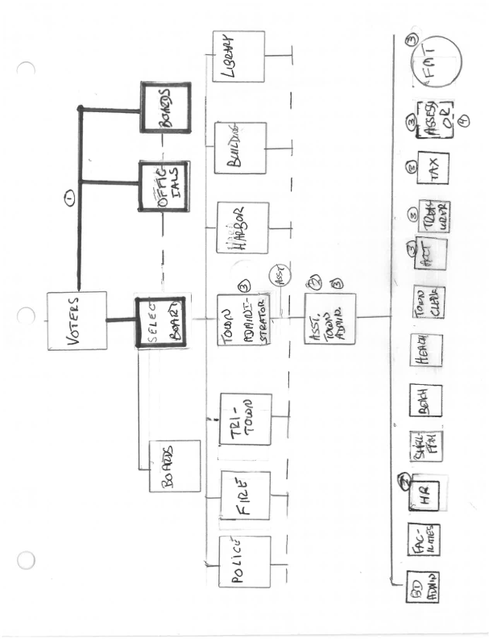
Recommended Organization Structure (Unofficial)

Slide 6
Organization Chart Notes
Bold = Elected
New roles
Assistant Town Manager (ATA)
Director, Human Resources
Finance Management Team
Composition
Town Administrator, ex officio; ATA, Chair; Assistant to Board of Assessors; Tax Collector; Town Accountant; Treasurer
Charter
Ensure coordination across all financial functions
Review/ensure timeliness of all deliverables
Troubleshoot as appropriate
Meeting frequency
Initially weekly, then as determined by team
Direct report of Board of Assessors

Slide 7
Recommendations: Town Administrator Role Overview
Reports to the Select Board
Duties include
Supervising Assistant Town Administrator (ATA), including on-boarding and continuing success
Ex officio, Financial Management Team
Scheduling regular office hours to be available to provide technical help and information
Advising SB on all matters pertaining to issues involving the town as defined by SB
Executing special projects – e.g., Chilmark School HVAC, fisherman storage and related area by the dump, driving the Peaked Hill housing project
Procurement
SB representative to Town Boards and Committees as designated by SB
Town Emergency Manager
Town insurance and compliance
Coordination of Town Meetings
SB Representative to MA Municipal Association
Making structural recommendations to the SB – e.g., DPW/Town Engineer

Slide 8
Recommendations: Assistant Town Administrator
Reports to Town Administrator
Designed to:
Enable Town Administrator to accomplish wide range of highest value-adding tasks
Chair, Financial Management Team
Provide Town staff access and resources they require to meet their goals in a timely, efficient, effective and rewarding way
Design and ensure the smooth operation of processes critical to the success of all staff and all functions
Ensures effective and efficient operating processes
Leads the design and/or continuous improvement of Town Hall operations and processes, including but not limited to planning, budgeting and financial reporting, etc.
Facilitate staff discussions and problem-solving as appropriate

Slide 9
Recommendations: Director of Human Resources
Reports to Assistant Town Manager
Leads Human Resource functions
Develop for review and approvement, and subsequently oversees implementation of, all HR processes – recruiting, on-boarding, job definition, documentation, compensation and benefits, performance management, training, coaching and development, exiting and knowledge transference
Serves as facilitator/coach for individuals and groups as appropriate

Slide 10
Recommendations: Process Design
Immediately, convene financial management team with facilitation support, to create integrated, coordinated calendars and schedules between and within all financial functions to increase efficiency and effectiveness and to reduce staff re-work and frustration

Slide 11
Recommendations: Process Design
Immediately, begin to design key Human Resource processes, such as retirement/off-boarding, onboarding, performance reviews, and conflict resolution

Slide 12
Next Steps
Develop full ATA, Director of HR Job Description
Ask Human Resource Board to grade proposed new role
Revisit HR functions and staff/HRB roles
Recommend to Select Board
Identify facilitator and create work-groups for Financial Management Team process design

