Slide 1
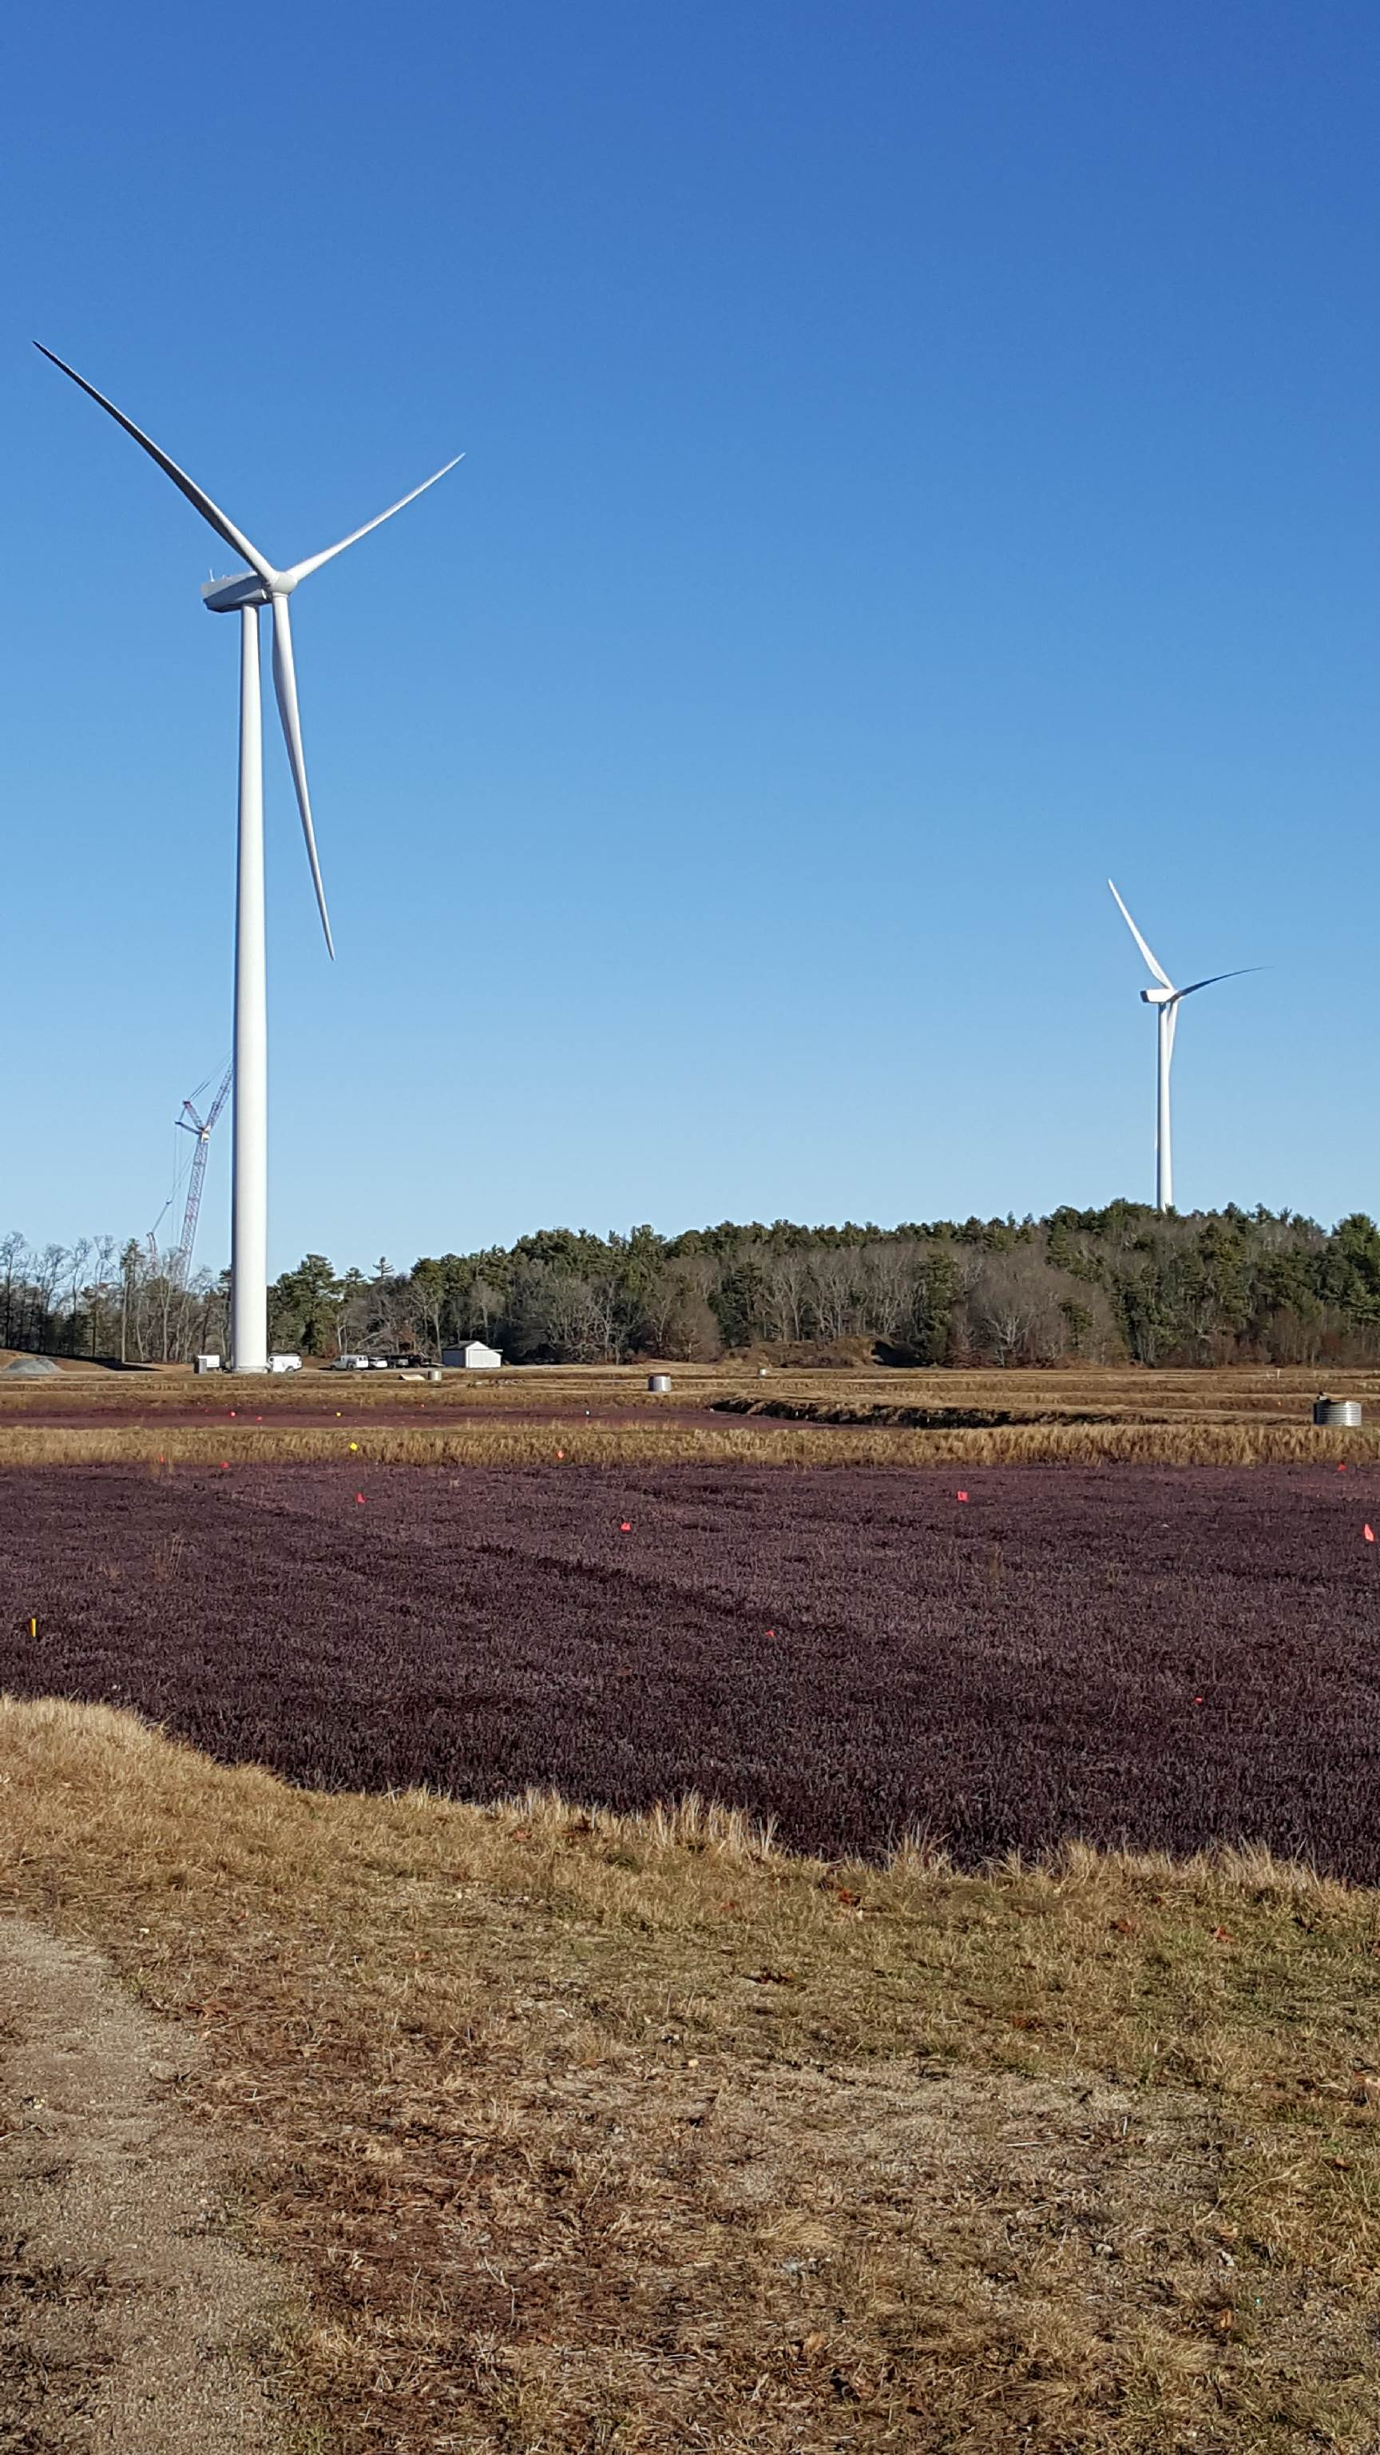
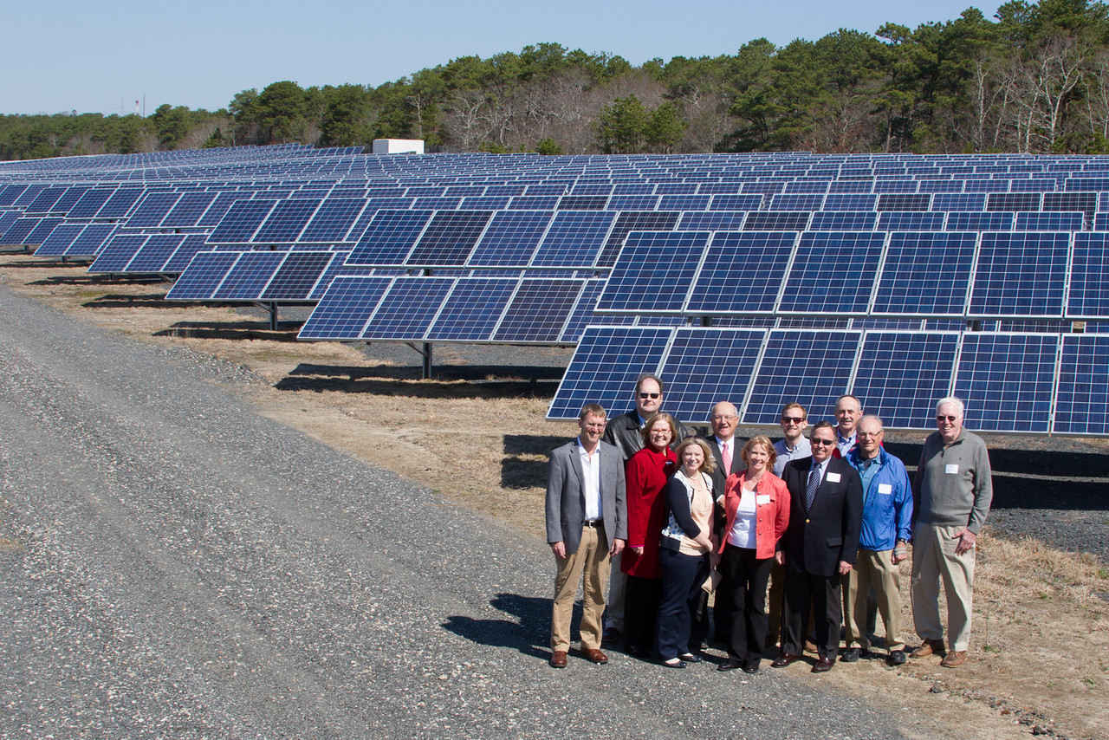
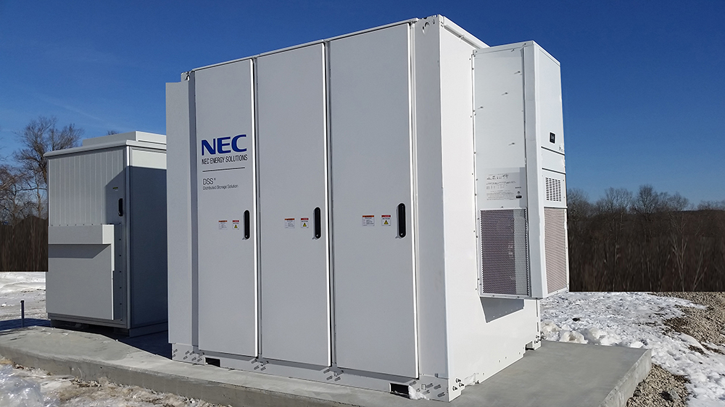
Next Steps: Site Plan approval: Stormwater Plan etc. NStar Interconnection Services Agreement Secure Net Metering Credit Assurance
Cape & Vineyard Electric Cooperative, Inc.
Town of Chilmark
FY20
Liz Argo, Executive Director
Maria Marasco, Deputy Director
William Lake, President
Stephen Lewenberg, Representative for Chilmark

Slide 2
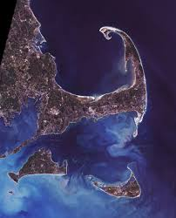
Cape & Vineyard Electric Cooperative, Inc.
Renewable Energy Installation and Sales
The Cape & Vineyard Electric Cooperative was organized under State statute, Chapter 146, on September 12, 2007
Three initial members: The Cape Light Compact, Barnstable County
and the Town of Barnstable
Now: 24 municipal members from on and off-Cape and 9 district participants
+++++++++++++++++++++++++++++++++++++++++++++++++++++++++++++++++
Mission: Renewable Energy
Power sales
Net Metering Credit benefits
ISO-NE market benefits to stabilize grid
Electric Vehicle (EV cars and stations)

Slide 3
Cape & Vineyard Electric Cooperative, Inc.
Renewable Energy Installation and Sales
Aquinnah
Barnstable
Bourne
Brewster
Chatham
Chilmark
Dennis
Edgartown
Eastham
Falmouth
Harwich
Oak Bluffs
Orleans
CVEC’s Participating Towns/Counties/Districts -
Nantucket
Sandwich
Provincetown
Tisbury
West Tisbury
Yarmouth
Barnstable County
Dukes County
Monomoy School District
Dennis Yarmouth School District
Barnstable Airport
Marion
Barnstable Fire District
Cotuit Water
COMM
Harwich Water
Sandwich Water
Upper Cape Regional Water
Nauset School District

Slide 4
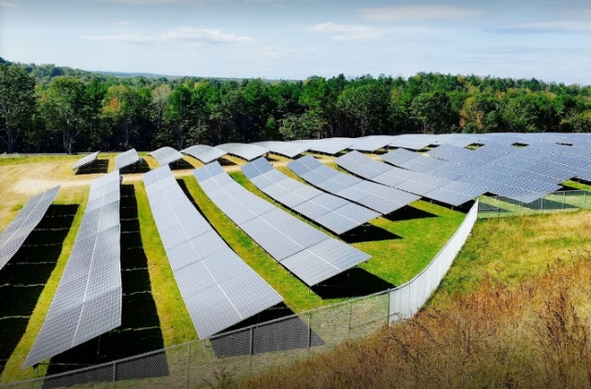
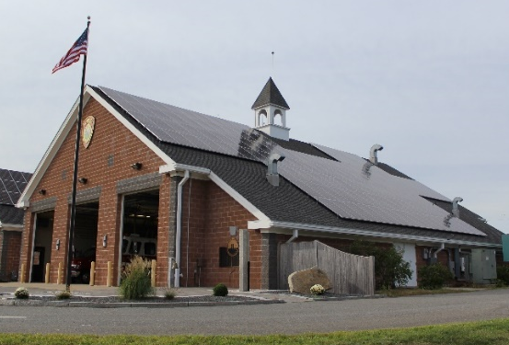
Cape & Vineyard Electric Cooperative, Inc.
Renewable Energy Installation and Sales
5 CVEC PV (& Storage) Initiatives:
CVEC-7 Initial Round = 750kW on roofs
Round 1 = 16MW, mostly on landfills
Round 2 = 12MW, on roofs & municipal lands
Round 3 = 1MW, on roofs
Round 4 = 12MW, canopies, roofs, lands With STORAGE
Round 5 = 14MW, canopies, roofs, lands With STORAGE
Round 6 = Collecting projects for FY21 Q1 RFP
Estimated installations by 2023 ~50MW
Edgartown’s Nunnepog
Yarmouth Fire Station #3

Slide 5
Cape & Vineyard Electric Cooperative, Inc.
Renewable Energy Installation and Sales
5 CVEC PV (& Storage) Initiatives:
CVEC-7 Initial Round = 750kW on roofs
Round 1 = 16MW, mostly on landfills
Round 2 = 12MW, on roofs & municipal lands
Round 3 = 1MW, on 7 roofs
Round 4 = 12MW, canopies, roofs, lands – STORAGE
50MW at end 2020
Round 5 ~ 14MW, canopies, roofs, lands - STORAGE
~ 64MW by 2023
Largest Cooperative power totals in New England
At end FY20, savings of over $16,900,000 to participants
Equivalent reduction of greenhouse gases

Slide 6
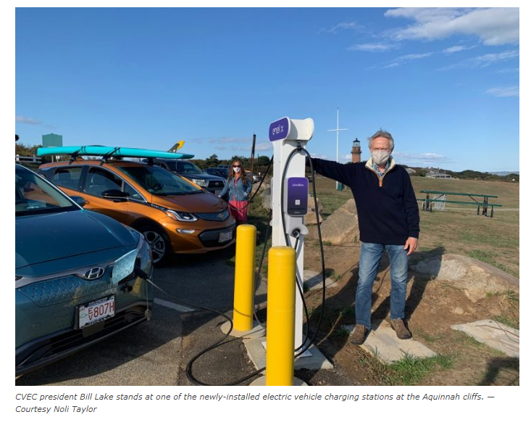
Cape & Vineyard Electric Cooperative, Inc.
Charging Stations

Slide 7
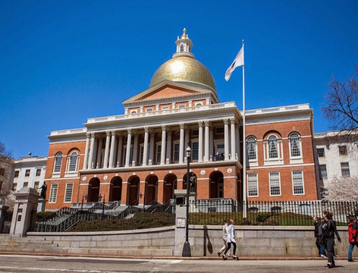
Cape & Vineyard Electric Cooperative, Inc.
Renewable Energy Installation and Sales
CVEC NMC Consultancy Management Services for:
Yarmouth, Sandwich, Provincetown, Dennis, Yarmouth
Legislative and
Regulatory Efforts:
Working with Senate to secure
relief from taxation of
municipal solar
Intervenor in Eversource case -
prevented devaluation of
Net Metering Credits
Member of Cape Cod Climate Change Collaborative

Slide 8
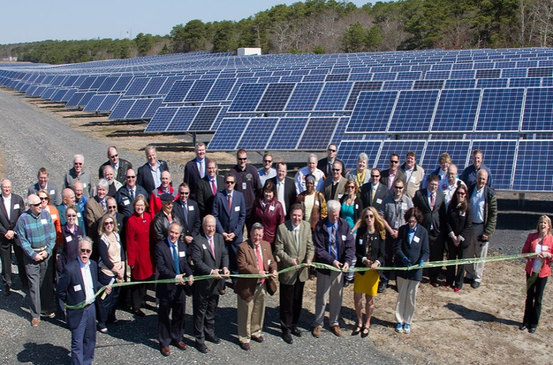
Cape & Vineyard Electric Cooperative, Inc.
CVEC in FY 2021
No Round 1 Adder collection!
Adding 20 MW of PV; including storage where possible
Broke ground on three Round 4 projects in October!
Starting on battery back-up at DY High School Emergency Shelter using $1.5 M Grant
Collecting Projects for PV/Storage Initiative Round 6

Slide 9
Cape & Vineyard Electric Cooperative, Inc.
Chilmark in FY20
Offtaker from CVEC PV projects:
Harwich, Tisbury & West Tisbury Capped Landfills, Barnstable Fire District project and Edgartown’s Nunnepog well project
AND
Offtaker from CVEC power sales:
Future Generation Wind and Nexamp

Slide 10
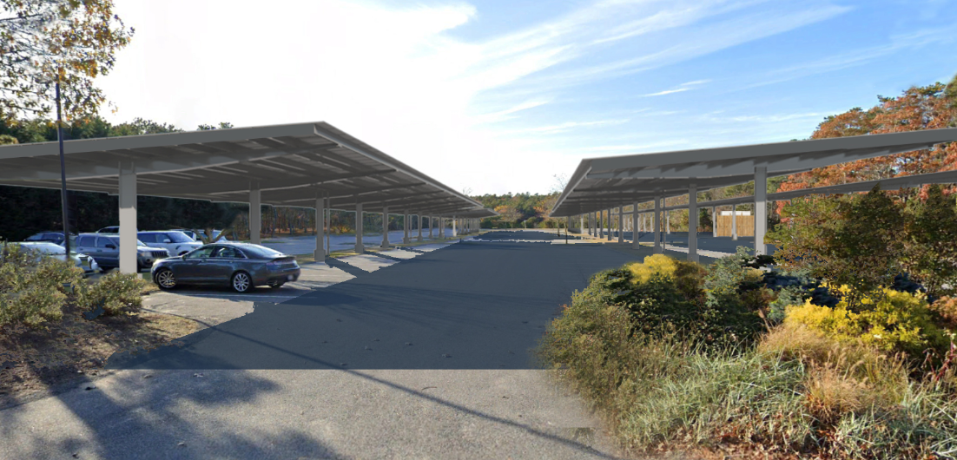
Cape & Vineyard Electric Cooperative, Inc.
Round 6 Possibilities
Solar Carport Canopy or Roof Mounted Solar for Chilmark
To provide power to adjacent facility
To provide resilience with battery storage
To participate in CVEC R6 RFP (~ Dec. ‘20)
Propose site(s)
Provide Letter of Intent
Carport Simulation

Slide 11
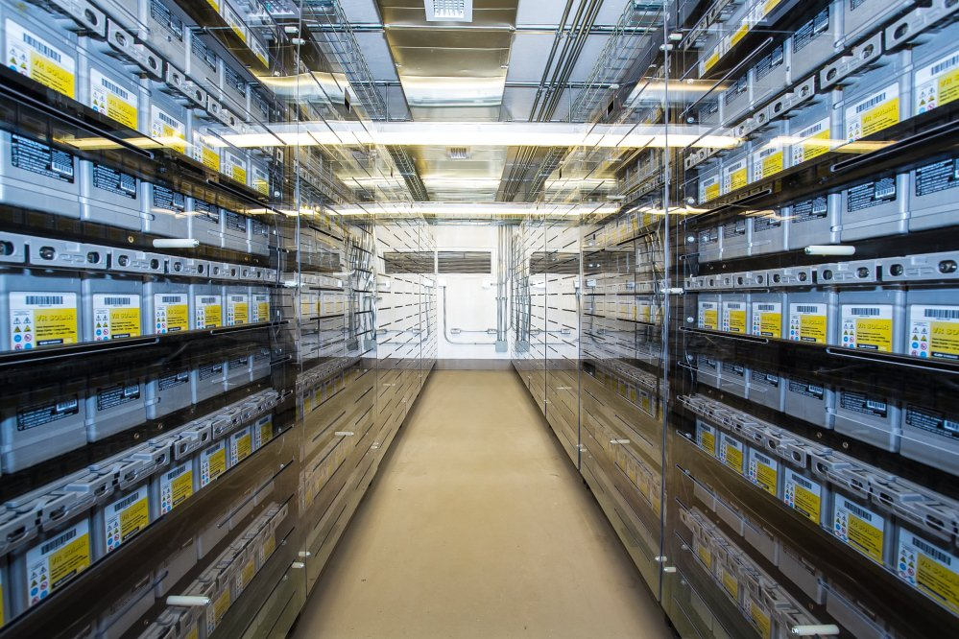
Next Steps: Site Plan approval: Stormwater Plan etc. NStar Interconnection Services Agreement Secure Net Metering Credit Assurance
Cape & Vineyard Electric Cooperative, Inc.
Questions?
Liz Argo, Executive Director
Maria Marasco, Deputy Director
William Lake, President
Stephen Lewenberg, Representative for Chilmark

