Slide 1
Proposed Nitrogen Sensitive Area/Watershed Permitting Regulatory Framework MassDEP / Town of Chilmark August 23, 2022

Slide 2
Meeting Agenda
Introductions- All
Meeting Objectives/ Milestones- Millie Garcia-Serrano, MassDEP SERO Regional Director
Presentation of Proposed Regulatory Framework- MassDEP
Nitrogen Sensitive Area (NSA) Designation
Establishing New Natural Resource Area NSA
Requirements and Exemptions
Watershed Permit
Application Components, Permit Requirements, Permitting Processes
Watershed Management Plan Update
CWMP Update
Anticipated needs for Plan completion/ update
Data gaps
Funding Opportunities - Maria Pinaud, MassDEP
SRF Program/Community Septic System Program/Loans
Other Programs (e.g. SNEP)
General Discussion/ Opportunity for feedback on proposed regulatory strategy, MassDEP
Next Steps- Millie Garcia-Serrano, MassDEP

Slide 3
Proposed Regulatory Framework
Background:
Stakeholder Group NSA Subcommittee met on September 3, 2020, February 23, 2021, & June 3, 2022 to discuss potential changes to Nitrogen Sensitive Area (NSA) provisions of Title 5
Topics discussed:
Expansion of definition of NSA
Defining how these areas might be determined
New nitrogen requirements for certain NSA areas
Compliance options
Implementation schedule for new requirements

Slide 4
Proposed Regulatory Framework (cont'd)
Current Title 5 regulations
Defines 'Drinking Water Protection' Nitrogen Sensitive Areas (NSAs) as:
Zone IIs, Interim Wellhead Protection Areas (IWPAs) and Facilities that utilize both on-site septic systems and non-public drinking water supply wells
Imposes loading restrictions (440 gpd/acre)
These provisions are maintained in Draft Regulations
Allows designation of nitrogen sensitive embayments through parallel regulatory change processes
Proposed Title 5 regulations
Establishes new designation of Natural Resource Area NSAs

Slide 5
Proposed Regulatory Framework (cont'd)
Natural Resource Area NSAs:
1) Any watershed to an embayment or sub-embayment that is the subject of a Nitrogen Total Maximum Daily Load (TMDL)* approved by the USEPA pursuant to the federal Clean Water Act and an Area Wide Water Quality Management Plan pursuant to Section 208 of the Clean Water Act addressing nitrogen pollution
* A “TMDL” is an EPA-approved calculation of the maximum amount of a pollutant allowed to enter a waterbody so that the waterbody will meet and continue to meet water quality standards for that particular pollutant. A TMDL determines a pollutant reduction target and allocates load reductions necessary to the sources of the pollutant

Slide 6
Proposed Regulatory Framework (cont'd)
Natural Resource Area NSAs:
All Cape Cod communities are subject to the “208 Plan” approved by EPA in 2015
There are currently 30 watersheds across Cape Cod with EPA-approved nitrogen TMDLs

Slide 7
Proposed Regulatory Framework (cont'd)
Natural Resource Area NSAs:
2) Any watershed to an embayment or sub embayment that is the subject of an EPA approved TMDL or determined to be nitrogen sensitive by MassDEP based on scientific evaluation and adopted through a public process involving public notice, including the scientific and regulatory rational for the designation, and a 60-day public comment period

Slide 8
Proposed Regulatory Framework (cont'd)
NSAs designation requires reduction in nitrogen migrating to impaired estuaries:
Option 1: Systems serving new construction/existing facilities must incorporate Best Available Nitrogen Reducing Technology within 5 years of the effective date of the NSA designation
OR
Option 2: Community(ies) operate under a Watershed Permit

Slide 9
Proposed Regulatory Framework (cont'd)
Best Available Nitrogen Reducing Technology:
An alternative system certified by MassDEP for general use pursuant to Title 5 which has the lowest effluent Total Nitrogen performance value
An alternative system granted provisional or pilot approval by MassDEP may also be utilized as long as such system has a Total Nitrogen performance value less than or equal to the lowest alternative system certified for general use by MassDEP

Slide 10
Proposed Regulatory Framework (cont'd)
Timing for implementing requirements for Natural Resource Area NSAs:
TMDL + 208 plan = NSA effective date of regulation promulgation
TMDL/Scientific Evaluation + Public Process = NSA effective date of designation

Slide 11
Proposed Regulatory Framework (cont'd)
Exemption from Enhanced Treatment Requirements for Natural Resource Area NSAs:
If communities obtain a Watershed Permit that covers an area that would be subject to new NSA regulations, the Title 5 NSA requirement to install Best Available Nitrogen Reducing Technology in 5 years would not apply

Slide 12
Proposed Regulatory Framework (cont'd)
Watershed Permit:
20-year permit instead of the traditional five-year permit
Issued to Local Government Unit, Regional Local Government Unit, Multiple local Government Unit (through Intermunicipal agreement)
Provides communities the opportunity to employ a greater range of solutions to address their water quality needs, including alternative or innovative approaches
Utilizes an adaptive management approach, requires monitor, evaluation, reporting of results, and modification of the approach as needed to address conditions that are causing the water quality impairments
Watershed Permit is based on a Town approved Watershed Management Plan

Slide 13
Proposed Regulatory Framework (cont'd)
Watershed Management Plan:
A long-term plan to address an existing water quality impairment to restore and protect water quality
Based on a Comprehensive or Targeted Watershed Management Plan
For watersheds with a TMDL, the plan must be designed to achieve compliance with the Water Quality Standards in the TMDL and demonstrate > 75% pollutant reduction within 20 years
MassDEP may determine an alternative schedule is appropriate based on watershed-specific issues

Slide 14
Proposed Regulatory Framework (cont'd)
Watershed Permit Application includes:
Estimated load reductions needed to meet the threshold concentration(s) at the sentinel station(s) for the selected Conventional Control Technologies and Alternative Control Approaches or Technologies
An implementation schedule, not to exceed 20 years, including a designated set of activities that will occur in the first 5-year block of time, and the results of which will enable the permittee to revise the implementation plans for the next 5-year period as necessary to meet load reduction requirements
Core Sewer Area and the service areas prioritized for wastewater collection and treatment after accounting for implementation of the selected Alternative Control Approaches and Technologies

Slide 15
Proposed Regulatory Framework (cont'd)
Watershed Permit Application includes:
A contingency plan for a back-up Conventional Control Technology will be provided in the event that the Alternative Control Approaches and Technologies selected do not function as predicted
The proposed approach to control 100% of all future pollutant loads to ensure that loads will always stay below the applicable threshold levels
Cost estimates for the infrastructure and programs associated with the proposed actions, if available

Slide 16
Proposed Regulatory Framework (cont'd)
Standard Watershed Permit Provisions:
The proposed activities, implementation schedule, and facilities included in the Watershed Management Plan shall be enforceable requirements, incorporated in a Watershed Permit
Annual report submittal
5- year evaluation and review
Public notice requirement and public meeting requirement for a permittee(s) to terminate permit coverage
Any permits issued by MassDEP that comprise a component of the implementation activities or are applicable to the pollutant discharges in the watershed shall be incorporated by reference into the Watershed Permit (i.e., Groundwater Discharge Permit)

Slide 17
Proposed Regulatory Framework (cont'd)
Watershed Permit Issuance Process:
Public Notice of the watershed Permit Application
MEPA Environmental Monitor
Newspaper circulated in the area of the Watershed Permit
MassDEP’s webpage
Comment Period of at least 60 days
A public hearing if requested by permittee or deemed necessary by MassDEP

Slide 18
Proposed Regulatory Framework (cont'd)
Watershed Permit Modification/Suspension/Revocation/Termination:
MassDEP will process permit modifications, suspensions or revocations in the same manner as an application for a Watershed Permit
If the permit is revoked, the Best Available Nitrogen Reducing Technology requirement applies to systems in the NSA
MassDEP may approve revisions to the schedule under certain circumstances (public notice is not required)
Permittees may terminate permits by providing advanced written notice to MassDEP following same process as the application
Upon termination, the Best Available Nitrogen Reducing Technology requirement applies to systems in the NSA

Slide 19
Proposed Regulatory Framework: Chilmark
Will Chilmark have automatic Natural Resource Area NSA designations?
How does the proposed regulatory framework impact Chilmark?
Is Chilmark within an area that has an EPA approved and EEA certified 208 Plan?
Does Chilmark have a watershed that drains to an estuary with an EPA approved Nitrogen TMDL?
What does Natural Resources Area NSA designation and watershed permit draft framework mean for Chilmark?
No. Chilmark is not on Cape Cod. Only the 15 Cape Cod Towns are within an area with an EPA approved and EEA certified 208 Plan. Areas outside of the Cape Cod Commission’s 208 plan are subject to subsequent designation.
Chilmark has time to evaluate and assess the best strategies for nitrogen reduction towards compliance with the TMDLs in each of the watersheds it can be held responsible for with potential future Natural Resource Area NSA designations. This will place the town in a good position for future watershed permitting.
Yes! Chilmark is the sole contributor of nitrogen load to the Chilmark Pond Embayment system and shares contribution of nitrogen load to Tisbury Great Pond Embayment system (TGP).

Slide 20
Proposed Regulatory Framework: Chilmark
Other considerations for how the regulatory framework can impact Chilmark.
Are there estuaries or ponds other than the Chilmark Embayment System and TGP System that could be designated as a NSA?
If found to be adversely impacted by nitrogen, will the TMDL for Long Cove Pond need to be issued before MassDEP can designate it as a NSA? Can the Menemsha Squibnocket watershed area still be designated without a TMDL?
Will any pond or estuary responsible to Chilmark for nitrogen load contributions have to go through the NSA public process before the designation.
What happens after designation?
Yes!
Long Cove Pond has not been evaluated yet. This pond has not been assessed for nitrogen impacts and can be designated in the future if identified to be adversely impacted by nitrogen through a scientific evaluation (MEP-like process). The Menemsha-Squibnocket system has been evaluated and was determined not to require a restorative TMDL for nitrogen impairment at this time.
Yes!
Since there are no automatic designations, any watershed designated as an NSA will have to go through the public process. The public process consists of a 60-day public notice period of MassDEP’s determination to designate the watershed. A public hearing can be held if deemed necessary after the 60-day public comment period. MassDEP will also provide a map of the watershed area.
Unless the Town receives a Watershed Permit for an exemption for a specific watershed, after designation of that specific watershed, all properties with septic systems will have to upgrade their Title 5 system with a Best Available Nitrogen Reducing Technology Septic System in 5 years from the date of designation
MassDEP can use a scientific evaluation (MEP-like study) proving impairment or a future approved TMDL to designate a watershed as a Natural Resource Area NSA. The designation would occur through a public process. Although, the Menemsha-Squibnocket watershed area was determined to not need a restorative TMDL, due to nitrogen impacts from sub-watersheds with nitrogen reduction targets, the watersheds could be designated to promote sustained embayment health.

Slide 21
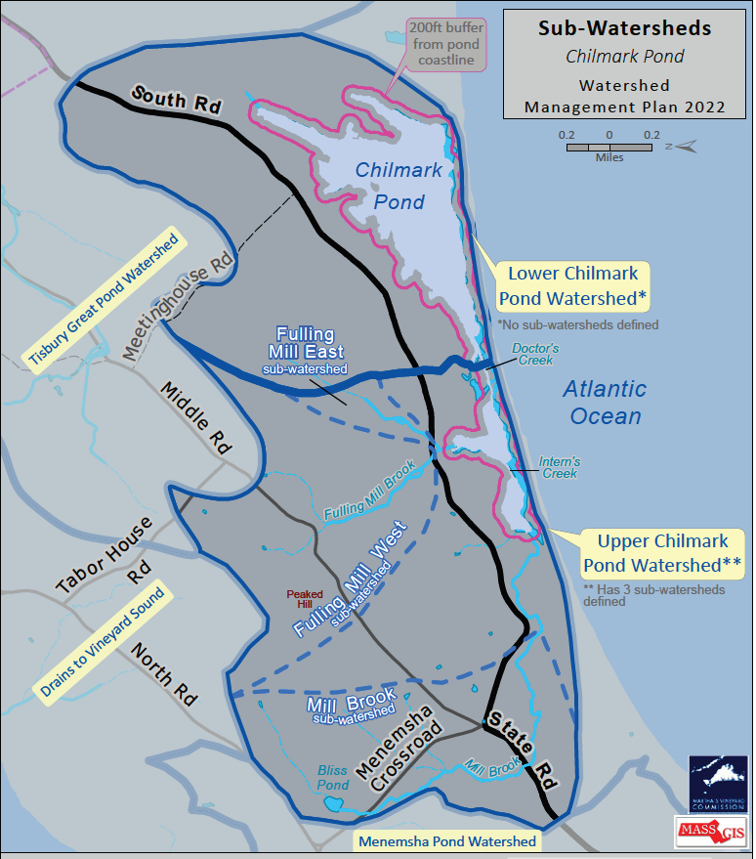
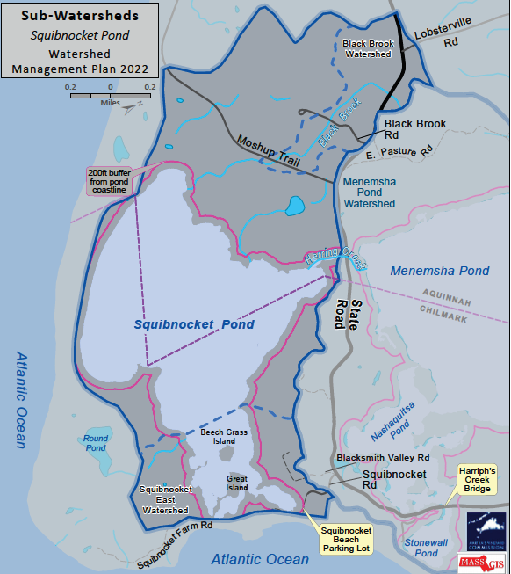
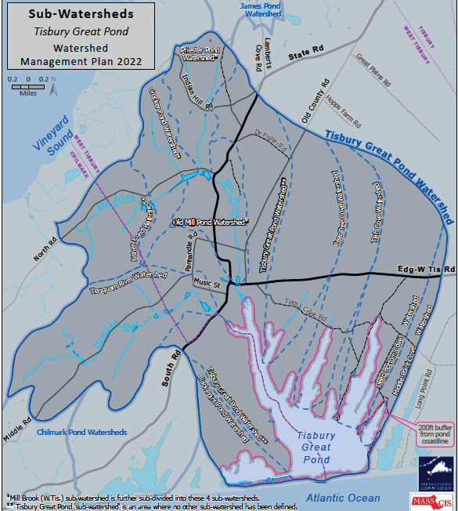
Watershed Management Plan Update
Chilmark Pond Embayment System, (MVC 2021)
Menemsha-Squibnocket Embayment System, (MVC 2021)
Tisbury Great Pond Embayment System & Long Pond , (MVC 2021)

Slide 22
SRF’s Community Septic Management Program (CSMP) Loan Model
The Massachusetts Clean Water Trust (Trust) dedicates $5 million a year to offer 2% interest rate loans to communities to fund their CSMP programs that provide loans to homeowners to replace their failed septic systems.
Over the past 5 years the CSMP has made 29 loans totaling $14.2 million at an average loan amount of $450,000. Additionally, the CWSRF has financed Barnstable County’s septic loan program, which now operates as its own revolving fund.

Slide 23
About the CSMP
The program operates on a rolling application basis and communities apply for financing when there is demand from homeowners.
Homeowners apply to the town for financing and the town draws down funds as needed from the Trust.
The loan to the community is secured with a general obligation pledge of the communities and receives the traditional debt authorization at the local level.
The loan to the homeowner is secured with a betterment agreement between the community and the homeowner, to which the Trust is not a party.
23

Slide 24
About the CSMP
Since the loan to the homeowner is secured with a betterment agreement, Massachusetts General Law governs that agreement and the interest rates that can be charged.
The interest charged by the community to the homeowner can be used to cover administrative expenses and to make new loans, which Barnstable County and others have done.
The draws made against the loan by the community operate under the Trust’s interim loan program and accrue no interest and no fees.
In most instances, the loan is put into repayment within two years or sooner if all the funds have been drawn or if the community decides they are finished with the program.
The Trust and MassDEP look forward to working with all Cape towns in developing solutions that work for the towns and do so at the lowest cost possible.
24

Slide 25
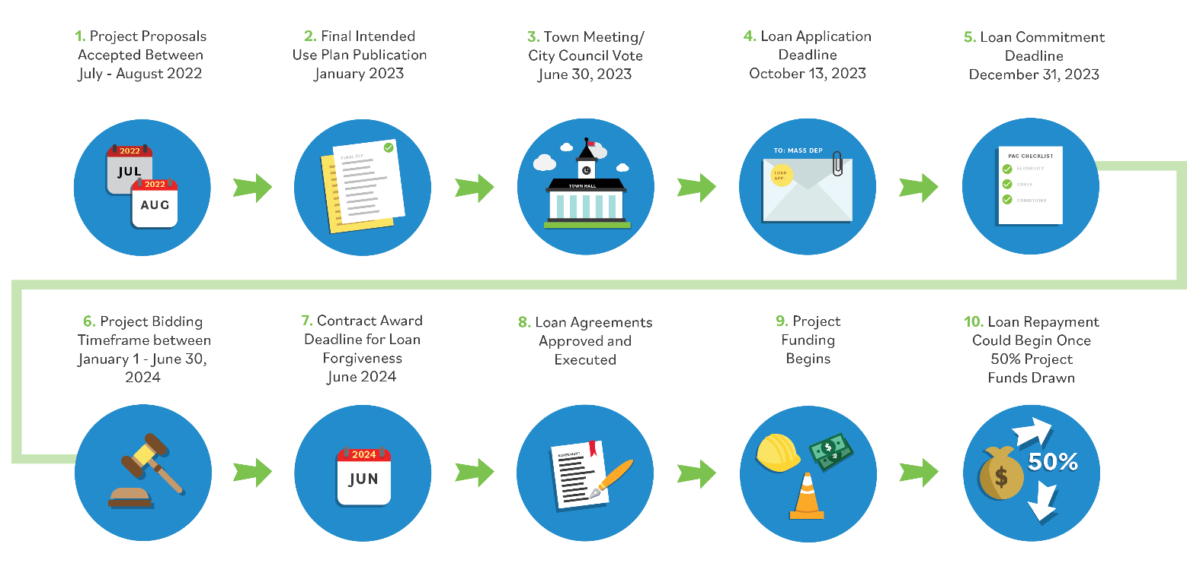
State Revolving Fund Loan Process
The SRF financing process can take up to two years, depending on the community and project, from the initial project proposal to funding being disbursed. MassDEP staff will provide assistance to the community from application submission to project completion.
THE MASSACHUSETTS CLEAN WATER TRUST AND MASSDEP
25

Slide 26
MassDEP Next Steps
Communication to Towns and Stakeholders
June 1, 2022, Regulatory Revisions Announcement Letter & Fact Sheet
Scheduling of MassDEP/ Town meetings- ongoing
Development of informational Webpage
310 CMR 15.000: Septic Systems ("Title 5") | Mass.gov
Table of Contents – Strategy for Nitrogen Impaired Estuaries
Development of Regulatory Revision- ongoing
Development of Funding Guidance- ongoing

Slide 27
General Discussion/ Feedback on Proposed Strategy

Slide 28
Points of Contact
Comments on Proposed Framework
Email: Marybeth.Chubb@mass.gov
Communication with Towns and Stakeholders
Cape/Islands/Southeastern MA Technical One-on-One Meeting Scheduling
Email: Millie.Garcia-Serrano@mass.gov
Email: Jennifer.Viveiros@mass.gov
Information on Funding
Email: Maria.Pinaud@mass.gov

Slide 29
MassDEP Contacts
Southeast Regional Office:
Millie Garcia-Serrano, Millie.Garcia-Serrano@mass.gov
Gerard Martin, Gerard.Martin@mass.gov
Jennifer Viveiros, Jennifer.Viveiros@mass.gov
Andrew Osei, Andrew.Osei@mass.gov
Ian Jarvis, Ian.Jarvis@mass.gov
Boston Office:
Kathleen Baskin, Kathleen.Baskin@mass.gov
Lealdon Langley, Lealdon.Langley@mass.gov
Marybeth Chubb, Marybeth.Chubb@mass.gov
Maria Pinaud, Maria.Pinaud@mass.gov
Timothy Jones, Timothy.M.Jones@mass.gov

Slide 30
Thank you!

